Slide 1
Climate Change Impact Analysis Using Statistical Methods and Data Visualization
Submitted in the partial fulfillment for the award of the degree of
BACHELOR OF ENGINEERING
IN
COMPUTER SCIENCE WITH SPECIALIZATION IN BIG DATA ANALYTICS
Submitted by:
Satyam Singh - 23BDA70056
Royal singh rana-23BDA70059
Ranbir Saini - 23BDA70105
Anish Sharma – 23BDA70027
Under the Supervision of: Mrs.Monica Luthra
DISCOVER . LEARN . EMPOWER
Department of AIT-CSE

Slide 2
Outline
Introduction to Project
Problem Formulation
Objectives of the work
Methodology used
4 phases of project
Results and Outputs
Future Scope
Conclusion

Slide 3
Introduction to Project
The Challenge:
Climate change is causing irregular rainfall, temperature fluctuations, and extreme weather conditions. These changes affect agriculture, water resources, and the environment. Large climate datasets are difficult to analyze manually, so proper statistical methods are needed to identify long-term patterns and trends.
The Solution:
This project uses 35 years (1990–2024) of NASA POWER climate data for Punjab region. Using Python libraries such as Pandas, NumPy, Matplotlib, and Seaborn, the data is cleaned, analyzed, and visualized. Statistical techniques like regression analysis and correlation help identify temperature and rainfall trends.
Target Audience & Need:
Farmer - crop planning and irrigation decisions
Researchers – climate trend studies
Students – data science learning and analysis
Government – policy making and disaster management

Slide 4
Problem Formulation
Existing Issues:
Irregular rainfall patterns
Temperature fluctuations over years
Extreme weather conditions increasing
Lack of local climate analysis
Limitations of Current Methods:
Manual analysis is time-consuming
Difficult to study large climate datasets
Less visualization of climate patterns
Hard to identify long-term trends accurately
Research Goal:
To analyze 35 years climate data using statistical methods and data visualization to identify temperature, rainfall, and environmental trends in Punjab region.

Slide 5
Objectives of the Work
Primary Goal:
To analyze climate change patterns using statistical methods and data visualization for better environmental understanding.
Key Tasks:
Collect 35 years climate dataset
Clean and preprocess data
Analyze rainfall trend
Analyze temperature trend
Create graphs and charts
Compare yearly and seasonal changes
Analyze performance differences and model behavior

Slide 6
Methodology used
Workflow Phases
Phase 1: Problem Identification
Identify project problem.
Find suitable solution
Phase 2: Data Collection and Analysis
Collect required dataset
Analyze data
Generate insights from data
Phase 3: Data Preprocessing
Start research paper writing
Reading and reviewing
Phase 4: Result presentation
Show final results.
Draw conclusion

Slide 7
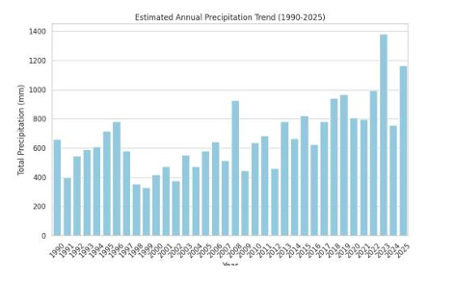
Results and Outputs
Annual mean temperature declined by −0.040°C/year
Maximum temperature declined by −0.053°C/year
Rainfall increased by +8.2 mm/year
Highest rainfall in 2023
Winter cooling observed
Sample Output
Trend analysis completed
Seasonal comparison done
Seasonal comparison done
Final report prepared

Slide 8
Future Scope
Advanced Enhancements:
Use AI/ML models for climate forecasting
Predict temperature and rainfall till 2050
Detect extreme weather events early
Improve data accuracy with satellite data
Industry Impact:
Helpful for farmers and irrigation planning
Supports disaster management
Supports disaster management
Technological Expansion:
Real-time climate monitoring system
Web/mobile dashboard for weather trends
Integration with IoT weather sensors

Slide 9
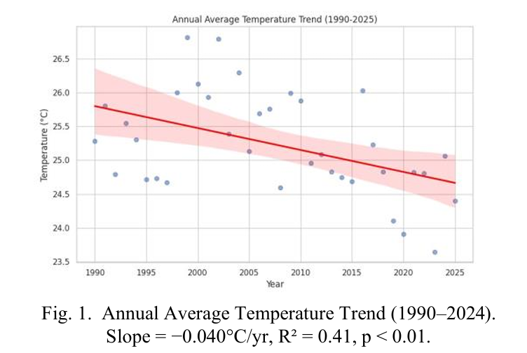
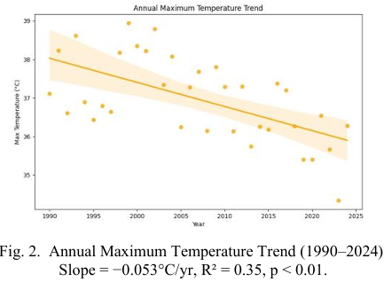
Graphs and Analysis

Slide 10
Conclusion
This project successfully analyzed 35 years (1990–2024) of climate data for the Punjab region using statistical methods and data visualization.
The study found that:
Annual mean temperature showed a declining trend
Maximum temperature also decreased
Rainfall increased over the years
Winter cooling was observed
Regional climate patterns changed significantly
These findings can help in agriculture planning, water resource management, and environmental decision-making.

